Slide 1

MIT 201: Advanced Data Structure & Algorithm Analysis
Master in information technology (mit)

Slide 2
Chapter 1: Overview Data Structure and Algorithm
Role of Data – Structures in Computation
Algorithm or Method versus Data Structure
Limits of Efficiency
Measuring Performance

Slide 3
Role of Data Structures in Computation
Three Basic Computation Steps
Computation = Sequence of Computation Steps
External Input
1. Locate/Access data - values
2. Compute a value
3. Store the new value
External Output

Slide 4
Role of Data Structures in Computation
Program: Algorithm + Data Structure + Implementation
Algorithm
The basic method; it determines the data – items computed.
Determines the order in which those data – items are computed and the order or read/write data – access operations
Data Structures
Supports efficient read/write of data items used/computed.
Total Time = Time to access/store data + time to compute data
Efficient Algorithm = Good Method + Good Data-Structures + Good Implementation

Slide 5
Algorithm or Method versus Data Structure
Problem: Compute the average of three (3) numbers
A Poor Implementation of (1) : Using 3 additions and 1 division
a = x + y ; // uses 2 additional assignments
b = a + z;
aver = b / 3
Two Methods: (1) aver = ( x + y + z ) / 3
(2) aver = ( x/3 ) + ( y/3 ) + ( z/3 )
Data Structures:
Three variables x, y and z.
An array nums[0..2].
This is inferior to (1) because accessing takes more time than accessing a simple variable.
When there are large number of data-items, naming individual items is not practical
Use of individually named data-items is not suitable when varying number of data-items are involved
A Poor Implementation of (2) : Using 3 additions and 3 division
a = x / 3 ; // uses 5 additional assignments
b = y / 3;
c = z /3;
d = a + b;
e = c + d;
aver = e

Slide 6

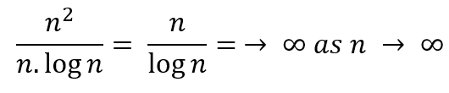
Limits of Efficiency
Hardware Limit:
Physical limits of time (speed of electrons) and space (layout of circuits). This limit is computation problem independent.
From 5 mips (millions of instruction per second) to 10 mips is an improvement by the factor of 2.
One nano-second = 10 raised to the power of -9 (one billionth of a second) a 10 mips is equivalent to 100 ns/instruction
Software Limit
Limitless in a way, except for the inherent nature of the problem. That is, the limit is problem dependent.
A1 is an improvement over A2 by the factor
O (n. log n) is the efficiency limit for sorting algorithm.

Slide 7

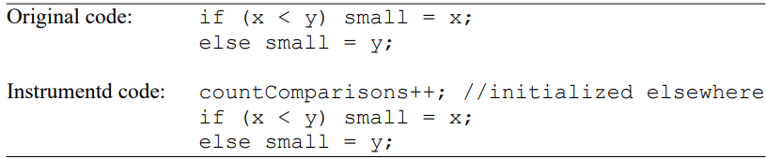
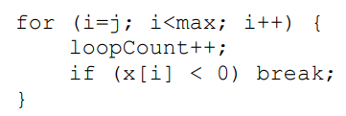
Measuring Performance
Analytic Method
Theoretical analysis of the Algorithm’s time complexity.
Empirical Method
Count the number of times specific operations are performed by executing an instrumented version of the program.
Measure directly the actual program-execution in time in a run.
Questions
What is wrong with the following instrumentation?
2. Instrument the code below for readCount and writeCount of x.
3. Show the new code when updates to loopCount is moved outside the loop.

Slide 8
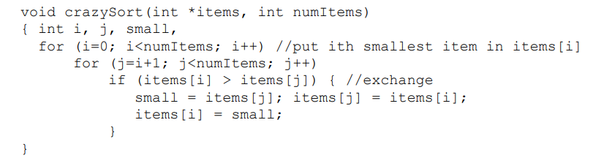
Exercises
Instrument the code below to count the number of exchanges (numExchanges) and number of comparisons (numComparisons) of the array data-items. Show the values of numExchanges and numComparisons after each iteration of the outer for-loop for the input item[] = [3,2,4,5,2,0].
If “i < numItems–1” in place of “i<numItems” in the outer for-loop, do the loop have the same result? Will it affect the execution time?
Is the algorithm in the code more closely related to insertion-sort or selection-sort? In what way does it differ from that?

Slide 9
Exercises
Given an array lengths[1..n] of the lengths of n line segments, find a method for testing if they can form a polygon (quadrilateral for n=4, pentagon for n=5, etc.).
Give a pseudocode for deciding whether three given line segments of lengths x, y and z can form a triangle, and if so whether it is a right–angled, obtuse-angled, or an acute-angled triangle. Make sure that you minimize the total number operations (arithmetic and comparisons of data-items)

